Slide 1
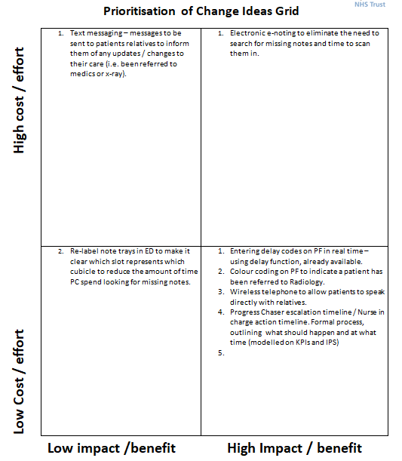
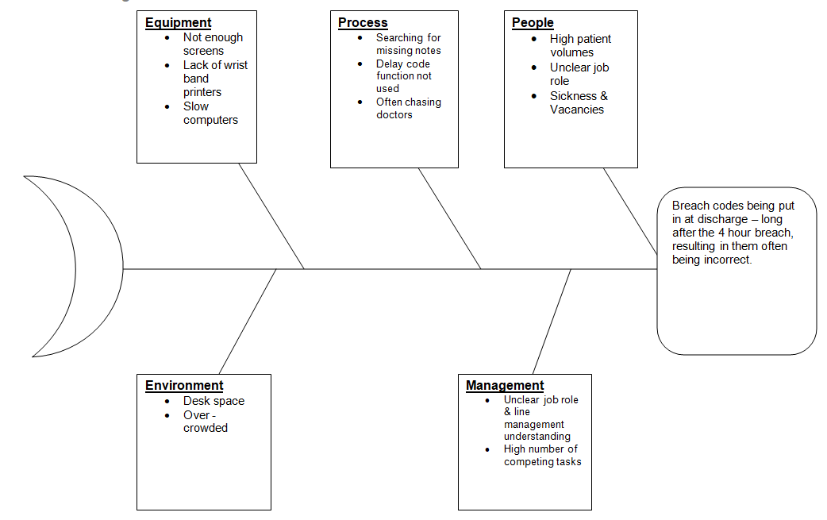
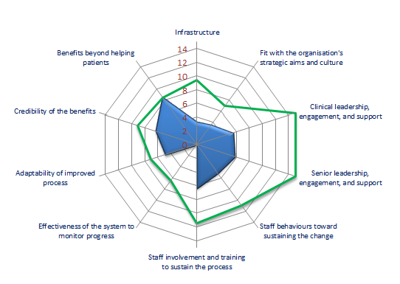
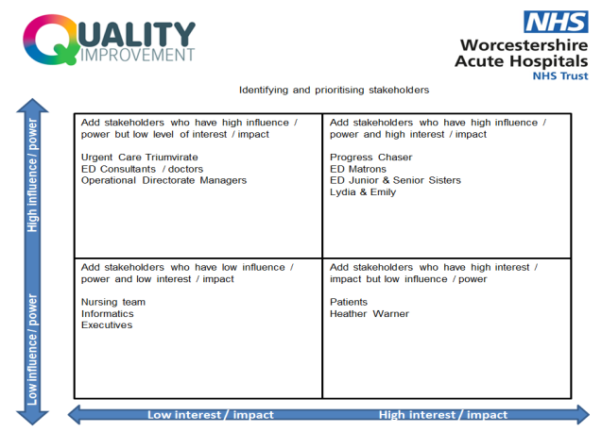
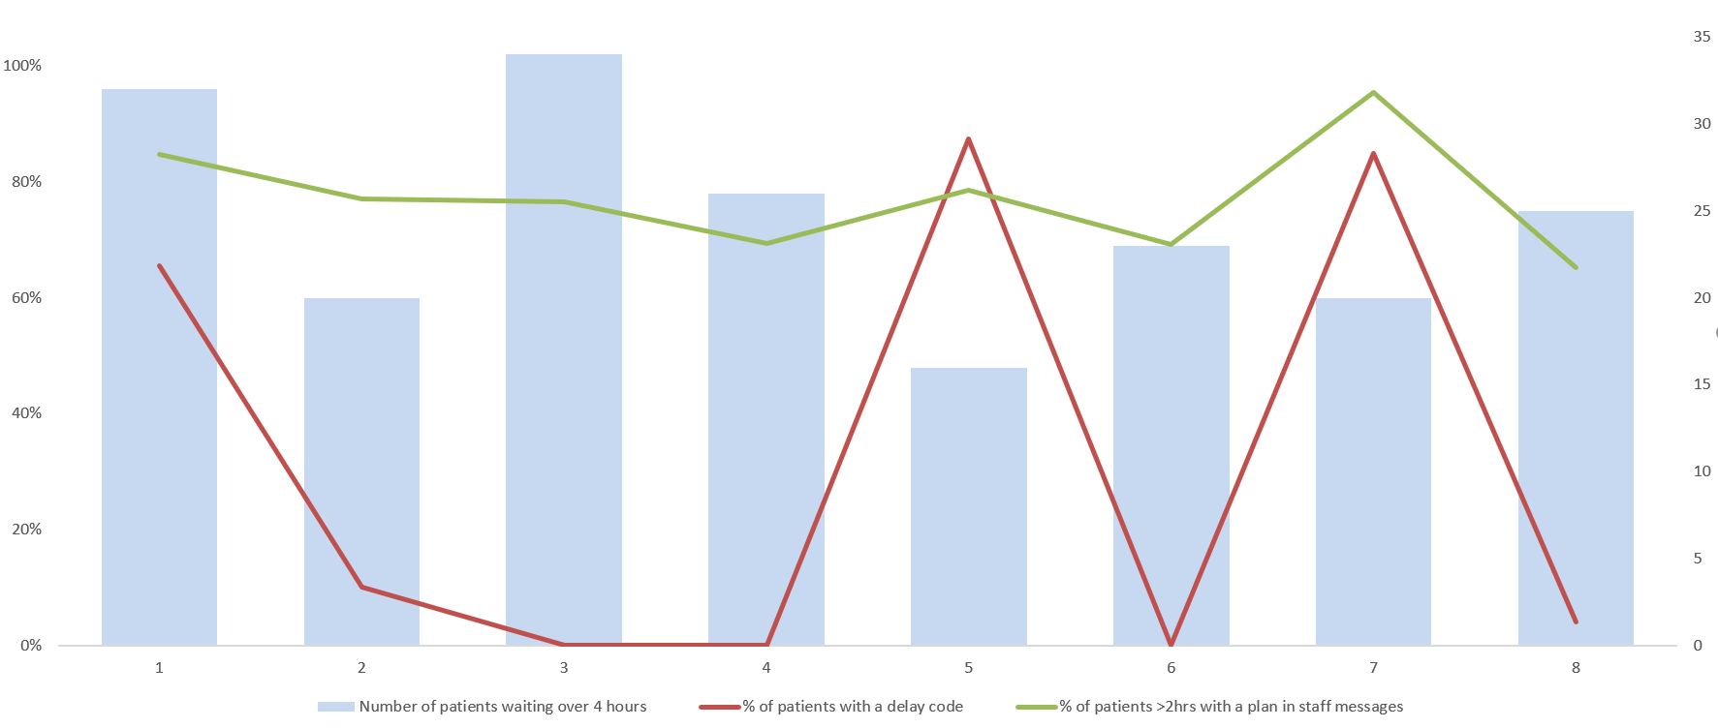
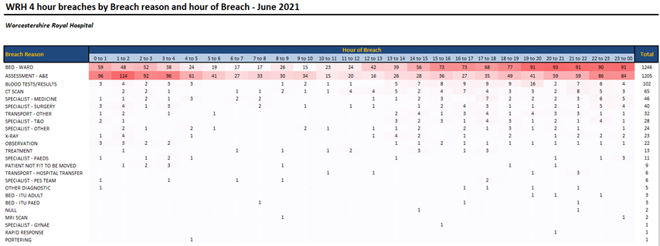
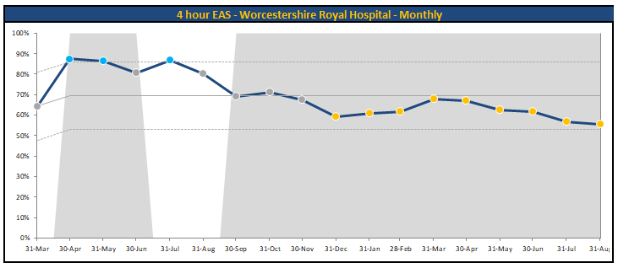
Emergency Department, Progress Chaser Improvement Project
Aim: From 1st December 2021, the need for retrospective 4 hour breach analysis at WRH will be eliminated. Lydia Humphries and Emily Carney
Why focus on Progress Chasers / Background
Ideas for change:
The most high-profile measure of A&E performance in England is the four-hour standard. (Emergency Access Standard EAS) This refers to the pledge in the NHS Constitution that at least 95 per cent of patients attending A&E should be admitted to hospital, transferred to another provider, or discharged within four hours.
At WAHT the 4 hour standard is imperative to reduce crowding.
To analyse our EAS performance notes would be looked at retrospectively to identify areas for improvement. However, it is acknowledged that the best data can be captured if delays are put in real time. To improve retrospective analysis we have proposed a system whereby the progress chasers enter delay codes in real time on the Patient First system.
Problem analysis:
Sustainability results:
Sustainability tool
Stakeholders
#.....
PDSA Tests of change:
Measurement for Improvement and Success
Initial Progress Chaser Survey
The use of delay codes is not consistent at present. The number of delay codes varies depending of the member of staff and in times of severe crowding delay codes are often not inputted. Staff messages with a clear plan are inputted for the majority of patients.
In summary, the use of delay codes does not appear to have been embedded. Anecdotal and audit feedback suggest crowding pressures play a big part in this, as well as associated competing tasks making it difficult for PC to find time to input accurate delay codes.

