Slide 1
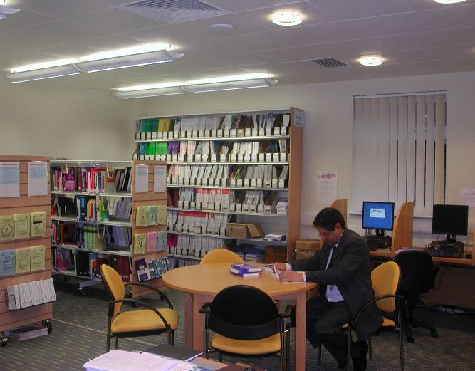
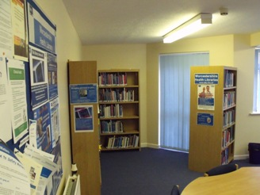
Worcestershire Health Libraries
Critical Appraisal
Kidderminster
Redditch
Evesham
Worcester

Slide 2
Evidence Based Medicine Critical Appraisal
"Evidence-based medicine refers to the application of the best available research to clinical care, which requires the integration of evidence with clinical expertise and patient values”
BMJ Best Practice

Slide 3
Shameless plug
www.wkp.nhs.uk

Slide 4
What we are going to do
Refresh memory on EBM
Locate some useful resources
Read through an article
Apply the CASP questions

Slide 5
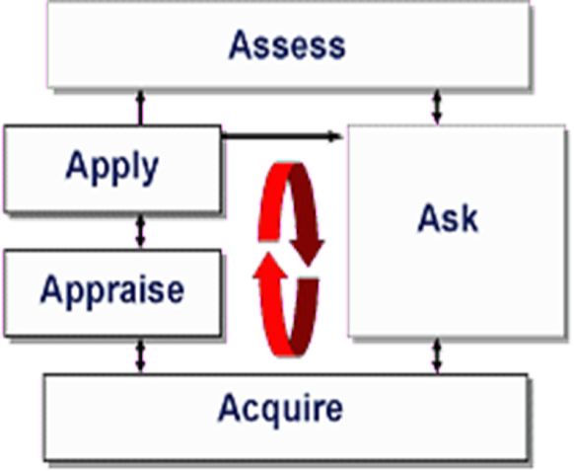
Why Critical Appraise?
Basic Evidence-Based Medicine
Clinical Audit – “gold” standard
Reflection
To be a better clinician
To offer the best treatment to an individual patient

Slide 6
What do you critical appraise?
Any resources that you use:
Websites, Point of Care/ Evidence summaries, articles, databases, opinions, guidelines, patient information and pathways

Slide 7
How to critical appraise?
Critical appraisal of published research: introductory guidelines. BMJ 1991;302:1136
Evidence based medicine: a movement in crisis? BMJ 2014;348:3725
Critical Appraisal Skills Program http://www.casp-uk.net/
CASP eleven question approach to trial articles
- Are the results valid?
- What are the results?
- Are they applicable?
Or https://www.sign.ac.uk/what-we-do/methodology/checklists/
Centre Evidence Based Medicine https://www.cebm.ox.ac.uk/resources

Slide 8
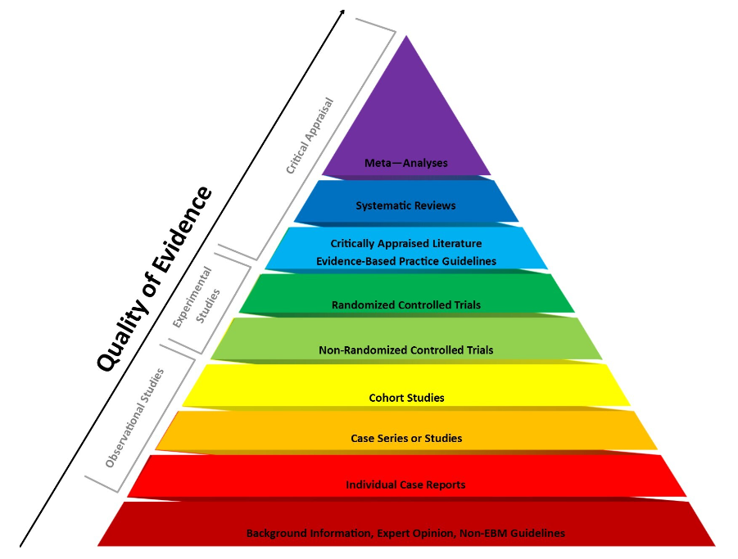
Hierarchy of Evidence
Diagram from Research Square
Notes:
Evidence-based medicine categorizes different types of clinical evidence and ranks them according to the strength of their freedom from the various biases that beset medical research
For example, the strongest evidence for therapeutic interventions is provided by systematic review of randomized, double-blind, placebo-controlled trials involving a homogeneous patient population and medical condition.
In contrast, patient testimonials, case reports, and even expert opinion have little value as proof because of the placebo effect, the biases inherent in observation and reporting of cases, difficulties in ascertaining who is an expert, and more.

Slide 9
Different papers different questions?
There are different types of research (RCTs, Systematic reviews, Cohorts…)
So there are different questions to ask to deal with Bias
Look at CASP and/ or SIGN for the different questions
http://www.casp-uk.net/
https://www.sign.ac.uk/what-we-do/methodology/checklists/

Slide 10
Critical Appraisal
Critical appraisal of any study design must assess:
Validity
Were sound scientific methods used?
Chance / Bias / Confounding Factors
Results
What are the results and how are they expressed?
Relevance
Are the findings generalisable – can they be applied to settings / situations outside the research study? Do these results apply to my local context?
Notes:
Whatever approach is used, you need to appraise the research paper for:
Validity
Results
Relevance

Slide 11
Potential Errors of research
Chance
A random error appearing to cause an association between an intervention and an outcome. Probability of a random error is estimated using statistics (p values & confidence intervals)
Bias
The deviation of results from the truth due to systematic error in the research methodology. E.g:
Selection Bias – may result in the sample being unrepresentative
Measurement Bias – issues related to how the outcome was measured e.g Instrument bias, recall bias, Attention bias
Intervention Bias – differences in the how the treatment was carried out or subjects exposed to the factor of interest e.g Timing bias, withdrawal bias, Contamination bias
Confounding Factors
Where part of the observed relationship between two variables is due to the action of a third variable
Known confounders: e.g. age, gender, smoking, etc.

Slide 12
Probability
How precise are the results?
A Probability value is a statement of how likely something is to be by chance.
A probability value of 1 would mean it was entirely due to chance. A probability of 0.5 would mean it had a 50% chance of being due to chance.
The magic figure that a study should reach is 0.05, which means there is only a 5% likelihood of a result being due to chance.
The lower the figure the better, so 0.005 would be very unlikely to be due to chance.
Generally, look for P<0.05 (1 in 20)

Slide 13
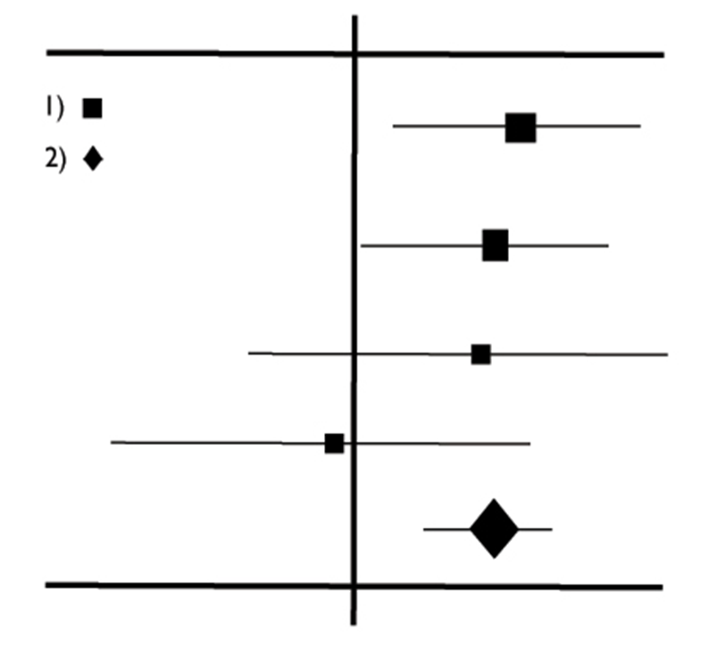
Confidence Intervals
An alternative way of assessing the effects of chance
The result of the trial is a “point estimate” – if you ran the trial again you will get a different result
The Confidence Interval gives the range in which you think the real answer
The 95% CI is the range in which we are 95% certain that the true population value lies
If the confidence intervals for individual studies overlap with this line, it demonstrates that at the given level of confidence their effect sizes do not differ from no effect for the individual study.
Look at how wide the interval is, and the values at each end
Individual sample size
Combined Results
Best Estimate
Confidence Interval
Favours Control

Slide 14
Look at an article
Moscati, R.M et al (2007) A multicenter comparison of tap water versus sterile saline for wound irrigation. Academic emergency medicine. 14(5) p.404-409
Read it through
Go through the CASP questions

Slide 15
1. Did the study address a clearly focused question?
Population: >17 yrs with uncomplicated skin lacerations requiring staple or suture repair. Lots of specific exclusions. Abstract and p. 405 Study Setting & Population
Intervention: Irrigation with tap water in sink or with normal saline using a sterile syringe. Abstract and p. 405 Study Protocol
Outcome: Wound infection rates. Abstract
The measurement of outcome is limited to wound infection. There is no measurement of other outcomes, such as patient satisfaction with the procedure, pain during the procedure, duration of procedure etc. Comment from College of Emergency Medicine appraisal

Slide 16
2. Was the assignment of participants to interventions randomised?
Randomised using envelopes that had been pre-randomised using computer-based random number generator. P.405 Study Protocol
Randomisation by numbered envelopes can be subverted. The recruiting clinician can throw away the allocated envelope and pick up a new one if they do not want to follow the randomisation. This can be detected by ensuring that all envelopes are accounted for at the end of the trial, but there is no mention of this being done. The imbalance in numbers between the two groups (374 v 339) could have been caused by medical providers discarding envelopes randomised to tap water or could simply be due to chance. Comment from College of Emergency Medicine appraisal
Similarity of groups – discrepancy in group size discussed above. Other factors shown in two tables p.407 – tables 1 and 2

Slide 17
3. Were all participants who entered the study accounted for at its conclusion?
They calculated their own attrition rate as 15% and actual dropout rate was below this (10% - not mentioned). P405 Data analysis and p406 Figure 1.
Dropouts explained p406 Results and figure 1.
Intention to treat analysis not discussed.
“An assessment of the people taking part in a trial, based on the group they were initially (and randomly) allocated to. This is regardless of whether or not they dropped out, fully adhered to the treatment or switched to an alternative treatment.” NICE

Slide 18
4. Were the participants ‘blind’ to intervention they were given? Were the investigators ‘blind’ to the intervention they were giving to participants? Were the people assessing/analysing outcome/s ‘blinded’?
Patients – couldn’t be blinded;
Health professionals – couldn’t be blinded;
Researchers – Follow up staff blinded (p405 Study Protocol) although for follow up in emergency department (ED) and by phone patients could have told them (p408 Limitations)

Slide 19
5. Were the study groups similar at the start of the randomised controlled trial?
Yes, testing a clearly defined intervention by comparing results in intervention and control group. Abstract and p. 405 Study Design
Two clearly defined groups (tap water and saline) and criteria P. 405 Study Setting and Population

Slide 20
6. Apart from the experimental intervention, did each study group receive the same level of care (that is, were they treated equally)? from the experimental intervention, were the groups treated equally?
Saline group – treated by health professional
Tap water group – treated by self and not supervised so could have irrigated for longer or shorter time. P405 Study Protocol
Same questions asked for follow up in ED and by phone. No figures on how many in each group were followed up by phone rather than in person. P405 Study Protocol and p408 Limitations

Slide 21
7. Were the effects of intervention reported comprehensively?
Power calculation was done and said they needed 1000 people but only 713 recruited. P405 Data Analysis and p406 Figure 1
Low numbers discussed in Limitations and suggestion made that the data could be used in a meta-analysis. This was later done by Cochrane P408 Limitations
Unusually there is no table showing results. Results were reported in terms of risk (3.3% in saline group, 4% in tap water group) and both absolute risk (0.7%) and relative risk (1.21) worked out. P406 Results, top paragraph, RH column.
Have not done numbers needed to treat but have applied costs to figures which show that treating with tap water is cheaper even at the worst case scenario. (At upper end of CI where wound infection rates would be greater and extra costs of e.g. antibiotics needed). P405/6 Results

Slide 22
8. Was the precision of the estimate of the intervention or treatment effect reported?
Confidence intervals are reported but not p-values. P406 Results
Stated that CIs were being worked out on comparison of proportions so results would be statistically significant if CI didn’t cross 1. P405 Data analysis
CI calculated on both Absolute risk reduction and relative risk and neither showed statistical significance. In both cases the CI crosses 1 showing that at some point the results could be the same in the two groups.
Relative risk: 1.21 (95% CI 0.5 to 2.7) (At 0.5 the infection rate in the tap water group was half that in the saline group; at 2.7 the infection rate in the tap water group could be more than twice that in the saline group).
Absolute risk: 0.7% (95% CI -2.24% to 3.64%)
P406 Results and p407 Discussion paragraph 1

Slide 23
9. Do the benefits of the experimental intervention outweigh the harms and costs?
Have to remember significant exclusions made (p405 Study Setting and Population) so results can only apply to those with uncomplicated skin lacerations.
Cost calculations are based on accepting the worst case scenario, (upper end of CI) (p407 Results) but should you be using a treatment where the results (on the measured outcome, i.e. wound healing) could actually be worse than on the control, just because it is cheaper?
If they raise the underpowering, this comment from CEM appraisal:
“it would take an unfeasibly large study to increase statistical power substantially. It is unlikely that a mega-trial of tap water versus sterile saline would be funded”.

Slide 24
10. Can the results be applied to your local population/ in your context?
Eight million traumatic wounds treated per year – USA
Wound infection common complication.
Cost, clinician time and risk mentioned. P. 404

Slide 25
10. Would the experimental intervention provide greater value to the people in your care than any of the existing interventions?
Participate time saved?
Can you re-invest any time saved
Participate clinician time increased/ reduced?
Participate satisfaction?
Other considerations:
Were the taps drinking water quality?
What was the temperature of the water?
What was the age and nutrition status of the participants as this can affect wound healing?
Data on other outcomes: patient satisfaction with procedure; pain during procedure etc?

Slide 26
Would you change your practice on the basis of what you have just read?

Slide 27
Overview
Ask a focused question
Research the evidence
Critically appraise evidence for its validity, effect size and precision
Apply the evidence in practice

Slide 28
Thank you
Any questions?
David Chamberlain
Library & Knowledge Services Manager
David.Chamberlian2@nhs.net

